Slide 1
Microprocessor System Design
درس ریزپردازنده
دکتر سید امید فاطمی
Omid Fatemi
Memory Interfacing
(omid@fatemi.net)

Slide 2
Outline
Memory module
Interfacing to memory
Address decoding
Chip select
Memory configurations

Slide 3
Minimum Mode
The first thing to provide?
Notes:
Memory, the first thing

Slide 4
A Memory Module
The Size:
Data bus?
Address bus?
Controls?
Read
Write
D7 - D0
A19 - A0
RD
WR

Slide 5
Minimum Mode
DEN
DT / R
AD7 - AD0
A15 - A8
8088
A19/S6 - A16/S3
#IOR
#IOW
ALE
IO and Memory Control?
RD
#MEMR
IO / M
#MEMW
WR

Slide 6
Minimum Mode
D7 - D0
DEN
DT / R
AD7 - AD0
A7 - A0
A15 - A8
A19 - A16
A15 - A8
MEMORY
8088
A19/S6 - A16/S3
ALE
RD
RD
IO / M
WR
WR

Slide 7
Processor Timing Diagram of 8088 (Minimum Mode) for Memory or I/O Read
T1
T2
T3
T4
CLOCK
__
DT/R
ALE
AD7 - AD0
A7 - A0
D7 - D0 (from memory)
A15 - A8
A15 - A8
A19/S6 - A16/S3
A19 - A16
S6 - S3
__
IO/M
if I/O ACCESS this is HIGH, if MEMORY ACCESS this is LOW
____
RD
______
DEN

Slide 8
Will the circuit be able to perform memory read?
;assume that initially the values
;of the registers are:
;BX = 1234, DS = 9000
MOV AL, [BX]

Slide 9
Processor Timing Diagram of 8088 (Minimum Mode) for Memory or I/O Read
T1
T2
T3
T4
CLOCK
__
DT/R
ALE
AD7 - AD0
A7 - A0
D7 - D0 (from memory)
A15 - A8
A15 - A8
A19/S6 - A16/S3
A19 - A16
S6 - S3
__
IO/M
if I/O ACCESS this is HIGH, if MEMORY ACCESS this is LOW
____
RD
______
DEN

Slide 10
Minimum Mode
D7 - D0
DEN
DT / R
AD7 - AD0
A7 - A0
A15 - A8
A19 - A16
A15 - A8
MEMORY
8088
A19/S6 - A16/S3
ALE
RD
RD
IO / M
WR
WR

Slide 11
Minimum Mode
D7 - D0
DEN
DT / R
AD7 - AD0
D7 - D0
Q7 - Q0
A7 - A0
A15 - A8
GND
OE
74LS373
A19 - A16
LE
A15 - A8
D7 - D0
Q7 - Q0
GND
OE
MEMORY
8088
74LS373
LE
A19/S6 - A16/S3
D7 - D4
Q7 - Q4
D3 - D0
Q3 - Q0
GND
OE
74LS373
ALE
LE
RD
RD
IO / M
WR
WR

Slide 12
Octal Transparent Latch with 3-State Output

Slide 13
Processor Timing Diagram of 8088 (Minimum Mode) for Memory or I/O Read (with 74373)

Slide 14
Minimum Mode
What about Data read and write

Slide 15
Minimum Mode
A7 - A0
B7 - B0
D7 - D0
DEN
E
74LS245
DT / R
DIR
AD7 - AD0
D7 - D0
Q7 - Q0
A7 - A0
A15 - A8
GND
OE
74LS373
A19 - A16
LE
A15 - A8
D7 - D0
Q7 - Q0
GND
OE
MEMORY
8088
74LS373
LE
A19/S6 - A16/
D7 - D4
Q7 - Q4
S3
D3 - D0
Q3 - Q0
GND
OE
74LS373
ALE
LE
RD
RD
IO / M
WR
WR

Slide 16
Processor Timing Diagram of 8088 (Minimum Mode) for Memory or I/O Read (with 74245)

Slide 17
Minimum Mode

Slide 18
Minimum Mode

Slide 19
Minimum Mode

Slide 20
Minimum Mode

Slide 21
Minimum Mode
2²⁰ bytes or 1MB
D7 - D0
D7 - D0
A19 - A0
A19 - A0
Simplified
Drawing of
MEMORY
8088 Minimum
Mode
MEMR
RD
MEMW
WR
CS

Slide 22
What are the memory locations of a 1MB (2²⁰ bytes) Memory?
A19 to A0 (HEX) | AAAA 1111 9876 | AAAA 1111 5432 | AAAA 1198 1000 | AAAA 7654 | AAAA 3210
00000 | 0000 | 0000 | 0000 | 0000 | 0000
FFFFF | 1111 | 1111 | 1111 | 1111 | 1111
Example: 34FD0
0011 0100 11111 1101 0000

Slide 23
Interfacing a 1MB Memory to the 8088 Microprocessor

Slide 24
Instead of Interfacing 1MB, what will happen if you interface a 512KB Memory?

Slide 25
What are the memory locations of a 512KB (2¹⁹ bytes) Memory?
A18 to A0 (HEX) | AAAA 1111 9876 | AAAA 1111 5432 | AAAA 1198 1000 | AAAA 7654 | AAAA 3210
00000 | 0000 | 0000 | 0000 | 0000 | 0000
7FFFF | 0111 | 1111 | 1111 | 1111 | 1111

Slide 26
Interfacing a 512KB Memory to the 8088 Microprocessor
AX
3F1C
BX
0023
What do we do with A19?
CX
0000
A19
DX
FCA1
A18
A18
7FFFF
36
CS
XXXX
:
:
7FFFE
25
SS
XXXX
A0
A0
7FFFD
19
DS
2000
:
:
ES
XXXX
D7
D7
:
:
:
:
20023
13
BP
XXXX
D0
D0
20022
7D
SP
XXXX
20021
12
MEMR
RD
20020
29
SI
XXXX
MEMW
WR
:
:
DI
XXXX
:
:
00001
95
IP
XXXX
CS
00000
23

Slide 27
What if you want to read physical address A0023?

Slide 28
What if you want to read physical address A0023?
A19 to A0 (HEX) | AAAA 1111 9876 | AAAA 1111 5432 | AAAA 1198 1000 | AAAA 7654 | AAAA 3210
A0023 | 1010 | 0000 | 0000 | 0010 | 0011
A19 is not connected to the memory so even if the 8088 microprocessor outputs a logic “1”, the memory cannot “see” this.

Slide 29
What if you want to read physical address 20023?
A18 to A0 (HEX) | AAAA 1111 9876 | AAAA 1111 5432 | AAAA 1198 1000 | AAAA 7654 | AAAA 3210
20023 | 0010 | 0000 | 0000 | 0010 | 0011
For memory it is the same as previous one.

Slide 30
Interfacing two 512KB Memory to the 8088 Microprocessor
AX
3F1C
A19
A18
7FFFF
36
BX
0023
A18
:
7FFFE
25
CX
0000
:
A0
7FFFD
19
DX
FCA1
A0
:
:
D7
D7
20023
13
CS
XXXX
:
:
20022
7D
SS
XXXX
D0
D0
20021
12
DS
2000
RD
20020
29
ES
XXXX
MEMR
WR
:
:
MEMW
CS
00001
95
BP
XXXX
00000
23
SP
XXXX
SI
XXXX
A18
7FFFF
12
DI
XXXX
:
7FFFE
98
A0
7FFFD
2C
IP
XXXX
:
:
D7
20023
33
:
20022
45
D0
20021
92
RD
20020
A3
WR
:
:
CS
00001
D4
00000
97

Slide 31
Interfacing two 512KB Memory to the 8088 Microprocessor
Problem: Bus Conflict. The two memory chips will provide data at the same time when microprocessor performs a memory read.
Solution: Use address line A19 as an “arbiter”. If A19 outputs a logic “1” the upper memory is enabled (and the lower memory is disabled) and vice-versa.

Slide 32
Interfacing two 512KB Memory to the 8088 Microprocessor
AX
AX
3F1C
3F1C
A19
A19
7FFFF
36
BX
BX
0023
0023
A18
A18
A18
7FFFE
25
CX
0000
:
CX
0000
:
:
7FFFD
19
DX
FCA1
A0
DX
FCA1
A0
A0
:
:
D7
20023
13
CS
XXXX
D7
D7
CS
XXXX
:
20022
7D
SS
XXXX
:
:
SS
XXXX
D0
20021
12
DS
2000
D0
D0
DS
2000
20020
29
ES
XXXX
MEMR
ES
XXXX
MEMR
RD
:
:
MEMW
MEMW
WR
00001
95
BP
XXXX
BP
XXXX
CS
00000
23
SP
XXXX
SP
XXXX
SI
XXXX
SI
XXXX
7FFFF
12
DI
XXXX
DI
XXXX
A18
7FFFE
98
:
7FFFD
2C
IP
XXXX
IP
XXXX
A0
:
:
D7
20023
33
:
20022
45
D0
20021
92
20020
A3
RD
:
:
WR
00001
D4
CS
00000
97

Slide 33
What are the memory locations of two consecutive 512KB (2¹⁹ bytes) Memory?
A19 to A0 (HEX) | AAAA 1111 9876 | AAAA 1111 5432 | AAAA 1198 1000 | AAAA 7654 | AAAA 3210
00000 | 0000 | 0000 | 0000 | 0000 | 0000
7FFFF | 0111 | 1111 | 1111 | 1111 | 1111
80000 | 1000 | 0000 | 0000 | 0000 | 0000
FFFFF | 1111 | 1111 | 1111 | 1111 | 1111

Slide 34
Interfacing two 512KB Memory to the 8088 Microprocessor
AX
3F1C
A19
BX
0023
A18
CX
0000
:
DX
FCA1
A0
CS
XXXX
D7
SS
XXXX
:
DS
2000
D0
ES
XXXX
MEMR
When the μP outputs an address between 80000 to FFFFF, this memory is selected
MEMW
When the μP outputs an address between 00000 to 7FFFF, this memory is selected
BP
XXXX
SP
XXXX
SI
XXXX
DI
XXXX
IP
XXXX

Slide 35
Interfacing two 512KB Memory to the 8088 Microprocessor
AX
3F1C
A19
BX
0023
A18
CX
0000
:
DX
FCA1
A0
CS
XXXX
D7
SS
XXXX
:
DS
2000
D0
ES
XXXX
MEMR
MEMW
BP
XXXX
SP
XXXX
SI
XXXX
DI
XXXX
IP
XXXX

Slide 36
Interfacing two 512KB Memory to the 8088 Microprocessor
AX
3F1C
A19
BX
0023
A18
CX
0000
:
DX
FCA1
A0
CS
XXXX
D7
SS
XXXX
:
DS
2000
D0
ES
XXXX
MEMR
MEMW
BP
XXXX
SP
XXXX
SI
XXXX
DI
XXXX
IP
XXXX

Slide 37
What if we remove the lower memory?
AX
3F1C
A19
BX
0023
A18
CX
0000
:
DX
FCA1
A0
CS
XXXX
D7
SS
XXXX
:
DS
2000
D0
ES
XXXX
MEMR
MEMW
BP
XXXX
SP
XXXX
SI
XXXX
DI
XXXX
IP
XXXX

Slide 38
What if we remove the lower memory?
AX
3F1C
A19
BX
0023
A18
CX
0000
:
DX
FCA1
A0
CS
XXXX
D7
SS
XXXX
:
DS
2000
D0
ES
XXXX
MEMR
When the μP outputs an address between 80000 to FFFFF, this memory is selected
MEMW
When the μP outputs an address between 00000 to 7FFFF, no memory chip is selected
BP
XXXX
SP
XXXX
SI
XXXX
DI
XXXX
!
IP
XXXX

Slide 39
Full and Partial Decoding
Full Decoding
When all of the “useful” address lines are connected the memory/device to perform selection
Partial Decoding
When some of the “useful” address lines are connected the memory/device to perform selection
Using this type of decoding results into roll-over addresses

Slide 40
Full Decoding
AX
3F1C
A19
BX
0023
A18
CX
0000
:
DX
FCA1
A0
CS
XXXX
D7
SS
XXXX
:
DS
2000
D0
ES
XXXX
MEMR
MEMW
BP
XXXX
SP
XXXX
SI
XXXX
DI
XXXX
IP
XXXX

Slide 41
Full Decoding
A19 to A0 (HEX) | AAAA 1111 9876 | AAAA 1111 5432 | AAAA 1198 1000 | AAAA 7654 | AAAA 3210
80000 | 1000 | 0000 | 0000 | 0000 | 0000
FFFFF | 1111 | 1111 | 1111 | 1111 | 1111
A19 should be a logic “1” for the memory chip to be enabled

Slide 42
Full Decoding
A19 to A0 (HEX) | AAAA 1111 9876 | AAAA 1111 5432 | AAAA 1198 1000 | AAAA 7654 | AAAA 3210
00000 | 0000 | 0000 | 0000 | 0000 | 0000
7FFFF | 0111 | 1111 | 1111 | 1111 | 1111
Therefore if the microprocessor outputs an address between 00000 to 7FFFF, whose A19 is a logic “0”, the memory chip will not be selected

Slide 43
Partial Decoding
AX
3F1C
A19
BX
0023
A18
CX
0000
:
DX
FCA1
A0
CS
XXXX
D7
SS
XXXX
:
DS
2000
D0
ES
XXXX
MEMR
MEMW
BP
XXXX
SP
XXXX
SI
XXXX
DI
XXXX
IP
XXXX

Slide 44
Partial Decoding
A19 to A0 (HEX) | AAAA 1111 9876 | AAAA 1111 5432 | AAAA 1198 1000 | AAAA 7654 | AAAA 3210
00000 | 0000 | 0000 | 0000 | 0000 | 0000
7FFFF | 0111 | 1111 | 1111 | 1111 | 1111
80000 | 1000 | 0000 | 0000 | 0000 | 0000
FFFFF | 1111 | 1111 | 1111 | 1111 | 1111
The value of A19 is INSIGNIFICANT to the memory chip, therefore A19 has no bearing whether the memory chip will be enabled or not

Slide 45
Partial Decoding
A19 to A0 (HEX) | AAAA 1111 9876 | AAAA 1111 5432 | AAAA 1198 1000 | AAAA 7654 | AAAA 3210
00000 | 0000 | 0000 | 0000 | 0000 | 0000
7FFFF | 0111 | 1111 | 1111 | 1111 | 1111
80000 | 1000 | 0000 | 0000 | 0000 | 0000
FFFFF | 1111 | 1111 | 1111 | 1111 | 1111
ACTUAL ADDRESS

Slide 46
Partial Decoding
A19 to A0 (HEX) | AAAA 1111 9876 | AAAA 1111 5432 | AAAA 1198 1000 | AAAA 7654 | AAAA 3210
00000 | 0000 | 0000 | 0000 | 0000 | 0000
7FFFF | 0111 | 1111 | 1111 | 1111 | 1111
80000 | 1000 | 0000 | 0000 | 0000 | 0000
FFFFF | 1111 | 1111 | 1111 | 1111 | 1111
ACTUAL ADDRESS

Slide 47
Interfacing two 512K Memory Chips to the 8088 Microprocessor

Slide 48
Interfacing one 512K Memory Chips to the 8088 Microprocessor

Slide 49
Interfacing one 512K Memory Chips to the 8088 Microprocessor (version 2)

Slide 50
Interfacing one 512K Memory Chips to the 8088 Microprocessor (version 3)

Slide 51
Interfacing Four 256K Memory Chips to the 8088 Microprocessor
A17
:
A0
D7
256KB
:
#4
D0
RD
WR
A19
CS
A18
A17
A17
:
:
A0
A0
D7
D7
256KB
:
:
#3
D0
D0
MEMR
RD
MEMW
WR
8088
CS
Minimum
Mode
A17
:
A0
D7
256KB
:
#2
D0
RD
WR
CS
A17
:
A0
D7
256KB
:
#1
D0
RD
WR
CS

Slide 52
Interfacing four 256K Memory Chips to the 8088 Microprocessor
A19
A18
A17
:
A0
D7
:
D0
MEMR
MEMW
8088
Minimum
Mode

Slide 53
Memory chip#__ is mapped to:
A19 to A0 (HEX) | AAAA 1111 9876 | AAAA 1111 5432 | AAAA 1198 1000 | AAAA 7654 | AAAA 3210
----- | ---- | ---- | ---- | ---- | ----
----- | ---- | ---- | ---- | ---- | ----

Slide 54
Interfacing four 256K Memory Chips to the 8088 Microprocessor
A19
A18
A17
:
A0
D7
:
D0
MEMR
MEMW
8088
Minimum
Mode

Slide 55
Interfacing four 256K Memory Chips to the 8088 Microprocessor
A19
A18
A17
:
A0
D7
:
D0
MEMR
MEMW
8088
Minimum
Mode

Slide 56
Interfacing four 256K Memory Chips to the 8088 Microprocessor
A19
A18
A17
:
A0
D7
:
D0
MEMR
MEMW
8088
Minimum
Mode

Slide 57
Interfacing several 8K Memory Chips to the 8088 μP

Slide 58
Interfacing 128 8K Memory Chips to the 8088 μP

Slide 59
Interfacing 128 8K Memory Chips to the 8088 μP

Slide 60
Memory chip#__ is mapped to:
A19 to A0 (HEX) | AAAA 1111 9876 | AAAA 1111 5432 | AAAA 1198 1000 | AAAA 7654 | AAAA 3210
----- | ---- | ---- | ---- | ---- | ----
----- | ---- | ---- | ---- | ---- | ----

Slide 61
Memory Terms
Capacity
Kbit, Mbit, Gbit
Organization
Address lines
Data lines
Speed / Timing
Access time
Write ability
ROM
RAM

Slide 62
ROM Variations
Mask Rom
PROM – OTP
EPROM – UV_EPROM
EEPROM
Flash memory

Slide 63
RAM Variations
SRAM
DRAM
NV-RAM
SRAM – CMOS
Internal lithium battery
Control circuitry to monitor Vcc

Slide 64
Memory Chip
8K SRAM
to be specific:
8Kx8 bits SRAM

Slide 65
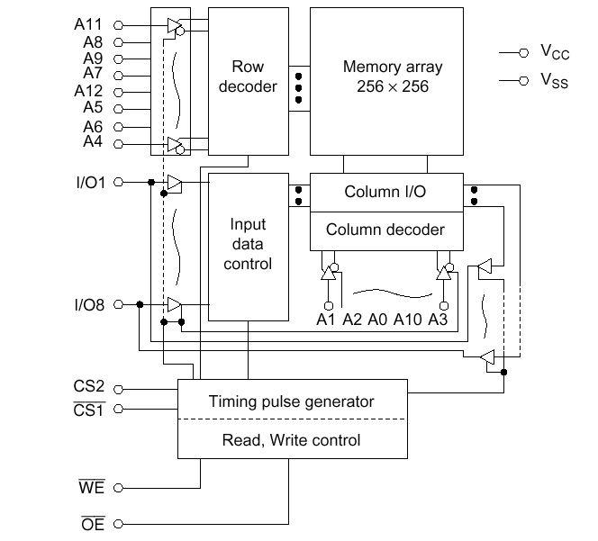
6264 Block Diagram

Slide 66
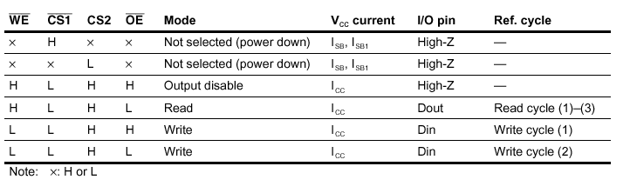
6264 Function Table

Slide 67
Interfacing 128 8K Memory Chips to the 8088 μP

Slide 68
8086 Machine Cycles
The key difference between the 8088 and the 8086 is the size of the data bus:
8-bit for 8088
16-bit for 8086
Thus the 8086 can transfer 2 bytes of instruction code or data in each machine cycle.

Slide 69
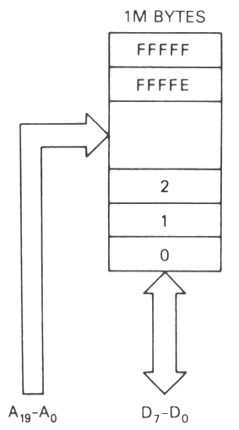
8088 Memory Organization Physical Implementation
Memory in the 8088 is stored in one (logical) bank. This bank might consist of several ICs.
All 20 address lines select the appropriate byte, either directly to the chip, or indirectly through chip select circuitry. Unused lines lead to mirror images.

Slide 70
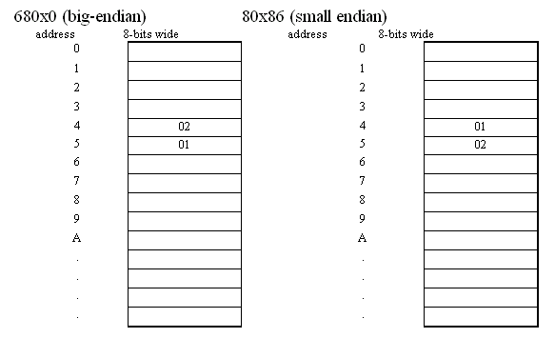
Little Endian / Big Endian
for the 68000:
MOVE.W #513, D0 ; move value 513 into the lower 16 bits of D0
MOVE.W D0,4 ; store the lower word of D0 into memory 4
for the 80x86:
MOV AX,513 ; load AX (16 bits), with the value 513
MOV [4],AX ; store AX into memory 4

Slide 71
80x86 family
16-bit Processors
8088 (8-bit data / 20-bit address)
8086/186 (16-bit data / 20-bit address)
80286 (16-bit data / 24-bit address)
32-bit Processors
80386 (16/24 or 32/32 common)
80486 (32/32), Pentium, PII (64/32)
Pentium Pro, II, III, IV (64/36)
PPC 60x (32 or 64/32)
All 80x86 processors use a 16-bit address for i/o
Notes:
We have to go to 16-bit micro to explain later about IO interfacing in them.

Slide 72
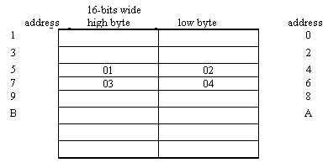
Memory Alignment in 16-bit Micro
We have 16-bit data bus
Why not use it for memory access.
1M byte of memory is organized as:
512K * 16 bit
The memory is word-aligned
Access to even addresses is aligned and simple
Example: 0102H and 0304H stored in [4H]
What happens on mov AX,[4]?
What happens on mov AX,[5]?
Motorola family of the MC680x0 forbids non-aligned access
Notes:
The answer for mov AX,[5] depends:
If the processor allows non-aligned access.
How to interface memory

Slide 73
Interfacing two 512KB Memory to the 8088 Microprocessor (review)
AX
3F1C
A19
7FFFF
36
AX
3F1C
A19
BX
0023
A18
A18
7FFFE
25
BX
0023
A18
CX
0000
:
:
7FFFD
19
CX
0000
:
DX
FCA1
A0
A0
:
:
DX
FCA1
A0
D7
D7
20023
13
CS
XXXX
D7
20022
7D
CS
XXXX
:
:
SS
XXXX
:
20021
12
SS
XXXX
D0
D0
DS
2000
D0
20020
29
DS
2000
ES
XXXX
MEMR
RD
:
:
ES
XXXX
MEMR
MEMW
WR
00001
95
MEMW
BP
XXXX
CS
00000
23
BP
XXXX
SP
XXXX
SP
XXXX
SI
XXXX
7FFFF
12
SI
XXXX
DI
XXXX
A18
7FFFE
98
DI
XXXX
:
7FFFD
2C
IP
XXXX
A0
:
:
IP
XXXX
D7
20023
33
:
20022
45
D0
20021
92
20020
A3
RD
:
:
WR
00001
D4
CS
00000
97

Slide 74
Interfacing two 512KB Memory to the 8086 Microprocessor
How to connect data lines?
How to connect address lines?
AX
3F1C
A0
7FFFF
36
BX
0023
A19
A18
7FFFE
25
CX
0000
:
:
7FFFD
19
DX
FCA1
A1
A0
:
:
D7
D7
20023
13
CS
XXXX
:
:
20022
7D
SS
XXXX
D0
D0
20021
12
DS
4000
20020
29
ES
XXXX
MEMR
RD
:
:
MEMW
WR
00001
95
BP
XXXX
CS
00000
23
SP
XXXX
SI
XXXX
7FFFF
12
DI
XXXX
A18
7FFFE
98
:
7FFFD
2C
IP
XXXX
A0
:
:
D15
D7
20023
33
:
:
20022
45
D8
D0
20021
92
20020
A3
RD
:
:
WR
00001
D4
BHE#
CS
00000
97

Slide 75
Address lines in 8086
Byte addressability should be considered.
Bytes in address 0 and 1 form a word.
This word could be accessed in one memory cycle.
Every even address (byte) with the corresponding odd address (byte) form a 16-bit word.
Address 0 and 1 from processor map to word 0 (row 0). Address 2 , 3 map to word 1. …
Address 2n and 2n+1 map to word n.

Slide 76
Interfacing two 512KB Memory to the 8086 Microprocessor
How to connect address lines?
What about chip select? (next slide)
AX
3F1C
A0
7FFFF
36
BX
0023
A19
A18
7FFFE
25
CX
0000
:
:
7FFFD
19
DX
FCA1
A1
A0
:
:
D7
D7
20023
13
CS
XXXX
:
:
20022
7D
SS
XXXX
D0
D0
20021
12
DS
4000
20020
1C
29
ES
XXXX
MEMR
RD
:
:
MEMW
WR
00001
95
BP
XXXX
CS
00000
23
SP
XXXX
SI
XXXX
7FFFF
12
DI
XXXX
A18
7FFFE
98
:
7FFFD
2C
IP
XXXX
A0
:
:
D15
D7
20023
33
:
:
20022
45
MOV [0040], AL?
MOV [0041], AH?
MOV [0040], AX?
D8
D0
20021
92
20020
3F
A3
RD
:
:
WR
00001
D4
BHE#
CS
00000
97

Slide 77
Memory Bank Select
8086/186/286/386SX has 16 Data Lines D15-D0
6264 Only has 8 I/O7 – I/O0
Must Use a “Memory Bank”
1 SRAM for Storing Bytes with “Even Addresses” (… 0 2 )
1 SRAM for Storing Bytes with “Odd” Addresses” (… 1 3 )
8086 has BHE Control Signal – (Bank High Enable)
Can Use Combination of A0 and BHE to Determine Type of Access
BHE A0 Access Type
0 0 1 word (16-bits)
0 1 Odd Byte (D15-D8)
1 0 Even Byte (D7-D0)
1 1 No Access

Slide 78
BHE - Bus High Enable
The BHE pin (#34) is the only physical difference between the 8088 and the 8086.
It is active low, which corresponds to most of the enable lines of memory devices (they are usually active low).

Slide 79
Physical Selection
The A₀ line and the BHE pin determine which bank is selected.
BHE A₀
0 0
0 1
1 0
1 1
Memory Access
Word D₀-D₁₅
Odd byte D₈-D₁₅
Even byte D₀-D₇
NONE

Slide 80
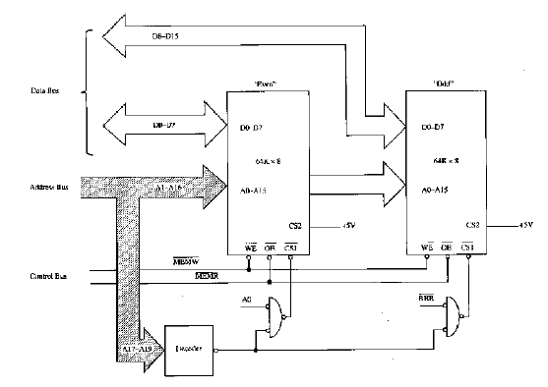
Decoding Circuit with Bank Select
Notes:
Note to A0 and BHE in Nand decoding circuit

Slide 81

8086 Memory Organization Physical Implementation (Chapter 3.2)
In 8086-based systems, memory is organized into 2 banks. Lines D₀-D₇ are connected to one, and lines D₈-D₁₅ to the other.
The A₀ and BHE lines select which bank to enable.
Both banks have identical address decoding circuits.

Slide 82
Dual Memory Banks
One consequence of the dual memory bank is that a word of data/instructions can only be loaded in one machine cycle if it starts on an even address.
This affects how you store data in the computer
Choosing a wrong address could lead to code that is almost 50% slower!
8-bit wide memory must be added in equal sized pairs.

Slide 83
Memory Alignment in 16-bit Micro (Summary)
We have 16-bit data bus
Why not use it for memory access.
1M byte of memory is organized as:
512K * 16 bit
The memory is word-aligned
Access to even addresses is aligned and simple
Example: 0102H and 0304H stored in [4H]
What happens on mov AX,[4]?
What happens on mov AX,[5]?
Motorola family of the MC680x0 forbids non-aligned access
Notes:
The answer for mov AX,[5] depends:
If the processor allows non-aligned access.
How to interface memory

Slide 84
Memory Chip
8K EPROM
to be specific:
8Kx8 bits EPROM

Slide 85
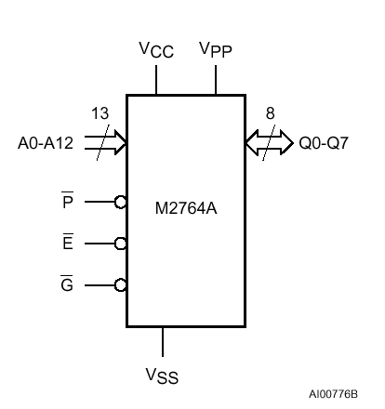
2764 Block Diagram
Chip enable
Output enable

Slide 86
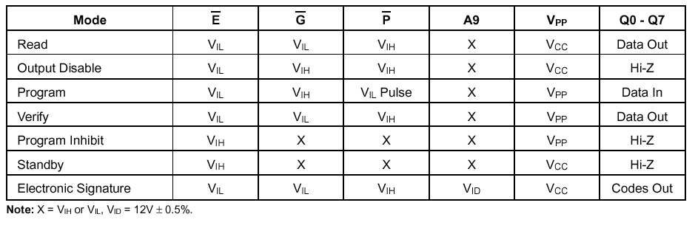
Operating Modes
Notes:
Program inhibit: disabling future programs.

Slide 87
Programming 2764
after each erasure for UV-EPROM):
all bits of the M2764A are in the “1" state.
The only way to change a “0" to a ”1" is by ultraviolet light erasure.
Programming mode when:
VPP input is at 12.5V
E and P are at TTL low.
The data to the data output pins.
The levels required for the address and data inputs are TTL.

